Slide 1

OBSTACLE AVOIDANCE ALGORITHM USING DEEP LEARNING
GUIDE:v.VEERABHAdram
DESIGNATION: Associate Professor
Abhirav Kulkarni(177Z1A0501)
A. Sai Vamshi(177Z1A0503)
M. Samuel Jayakumar(177Z1A0552)

Slide 2
Abstract
.Navigation is one of the most important tasks of mobile robots.
Inspired by the advantages of the hierarchical feature extraction of deep learning, this work investigates the development of a very deep Convolutional Neural Network algorithm to solve the problem of the mobile robot obstacle avoidance in an indoor environment.
The algorithm takes raw images as input and generates control commands as network output. Control commands include go straight-forward, turn-full-left, turn-half-left, turn-full-right, and turn-half-right

Slide 3
Introduction
Navigation is one of the most important tasks of mobile robots, where staying operational while avoiding collisions and maintaining safety standard are priorities in mobile robots. Thus, the objective of the robot’s motion planning and control is to find collision-free paths between two positions.

Slide 4
EXISTING SYSTEM
Classical perception methods extract information from the raw sensors readings based on artificially designed complex features.
These methods are designed to adopt to generic environments.
These methods are prone to errors when they encounter unstructured dynamic environments wide illuminations differenced and different terrain types.

Slide 5
PROPOSED SYSTEM
The objective of the robot’s motion planning and the control is to find Collison free paths between two positions.
To achieve the main objective a new dataset is complied using depth images (RGBD) .
The baseline control algorithm chosen in this work is the VGG16(convolution neural network model for large scale image recognition)

Slide 6
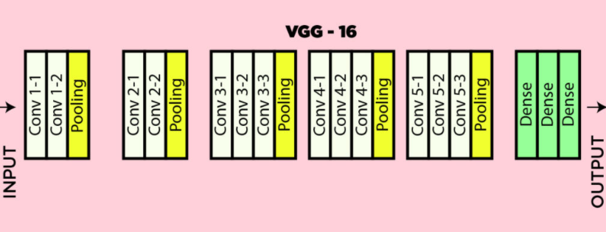
VGG architecture

Slide 7
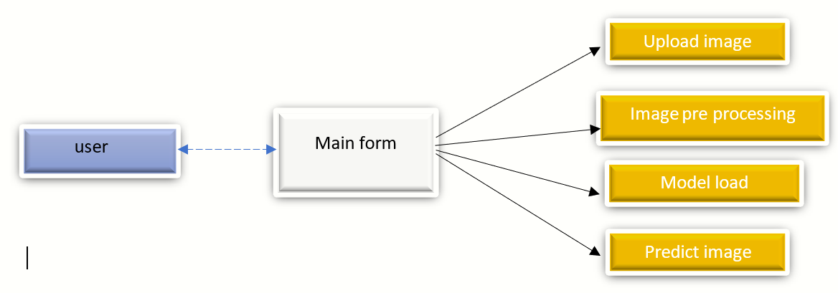
Block diagram

Slide 8
CLASS DIGARAM

Slide 9
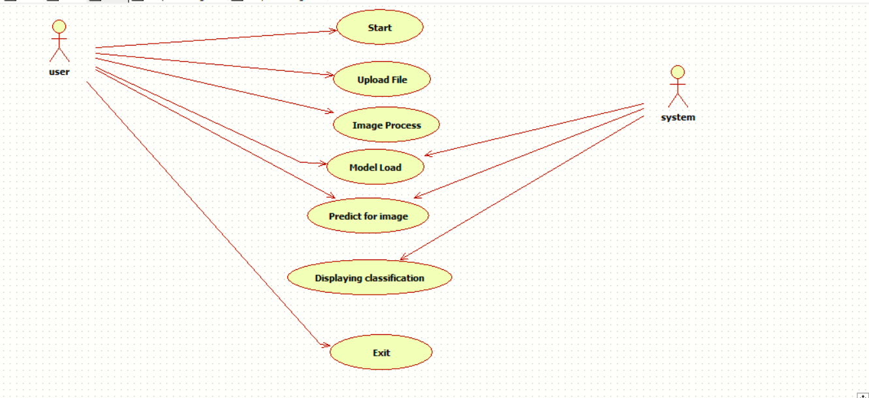
USE CASE DIAGRAM

Slide 10
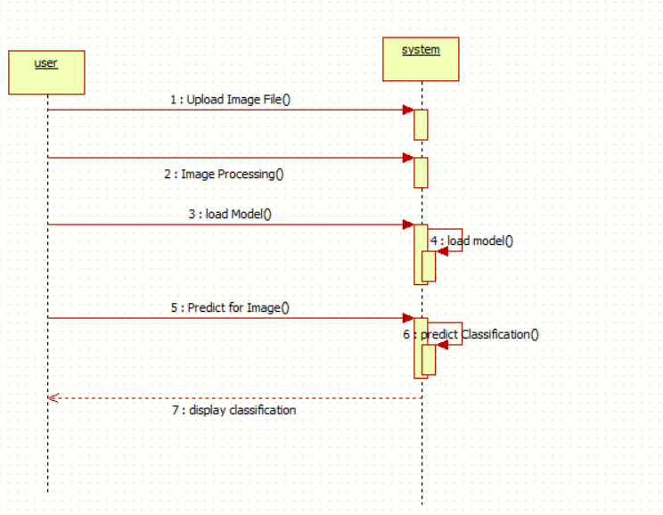
SEQUENCE DIAGRAM

Slide 11
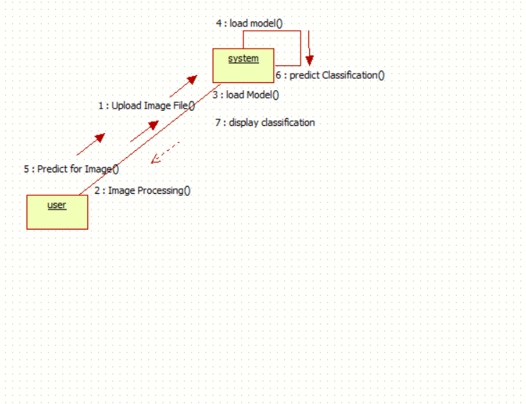
COLLABRATION DIAGRAM

Slide 12
ACTIVITY DIAGRAM

Slide 13
COMPONENT DIAGRAM

Slide 14
ADVANTAGES
Robustness
Accuracy
Less errors

Slide 15
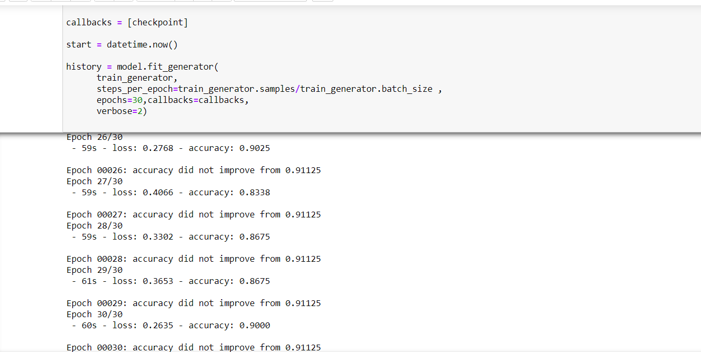

Slide 16
SYSTEM REQUIRMENTS
SOFTWARE REQUIRMENTS:
Operating System : Windows 10
Technologies : Keras,OpenCv,Tkinter,NumPy, TensorFlow

Slide 17
HARDWARE REQUIRMENTS:
Os :Windows and Linux
Processor : Intel i5
Speed : 3 GHz
RAM : 8GB
Harddisk : minimum 250gb

Slide 18
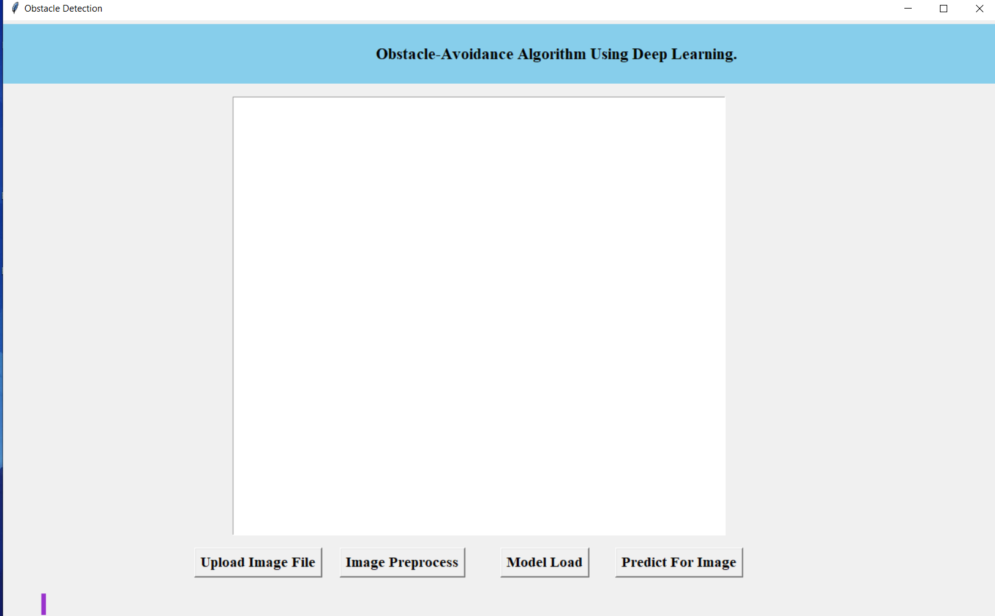
Output screens
Opening screen

Slide 19
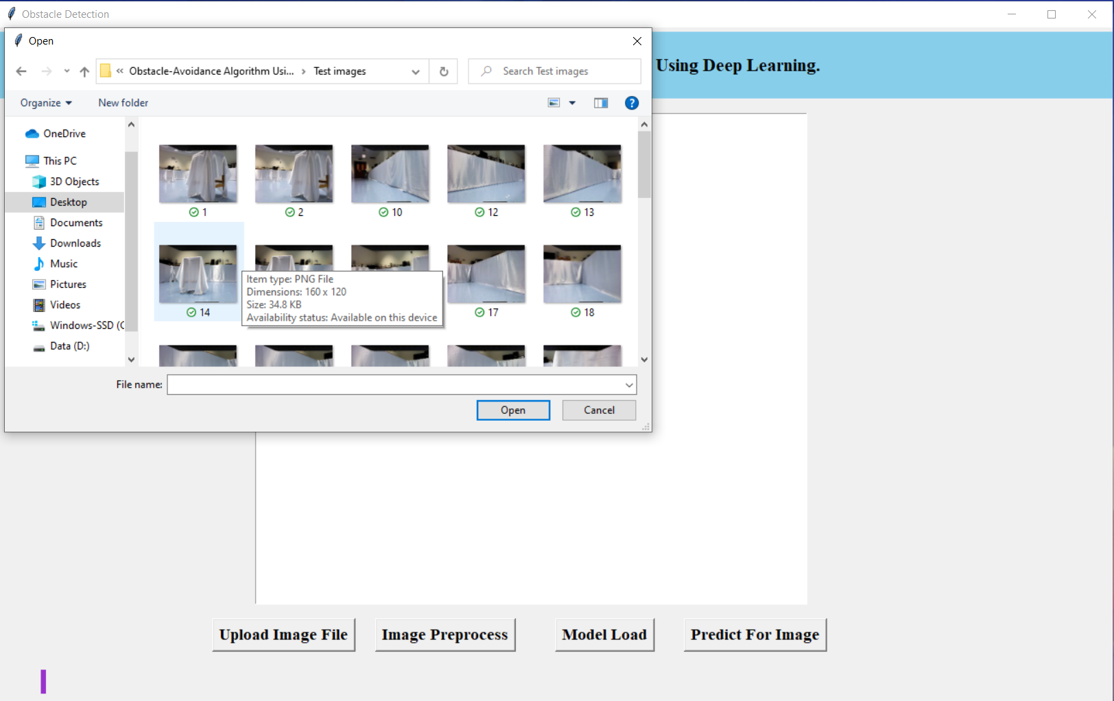
Loading dataset

Slide 20
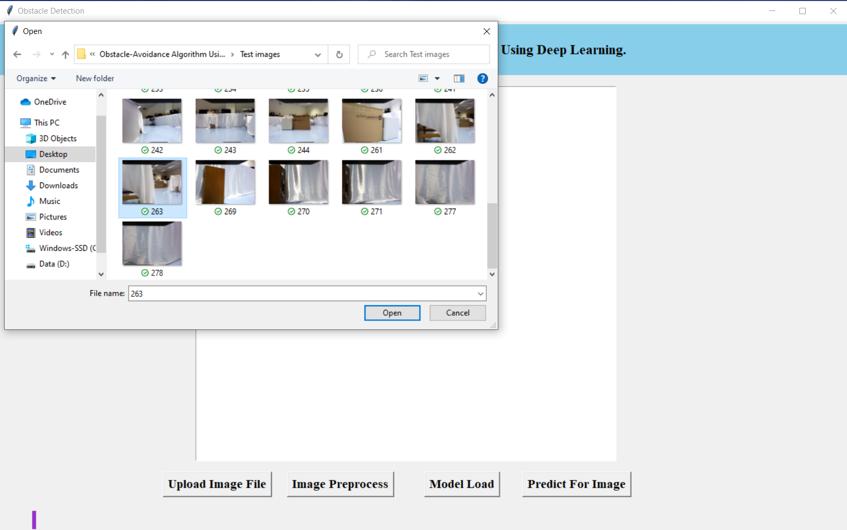
Loading dataset

Slide 21
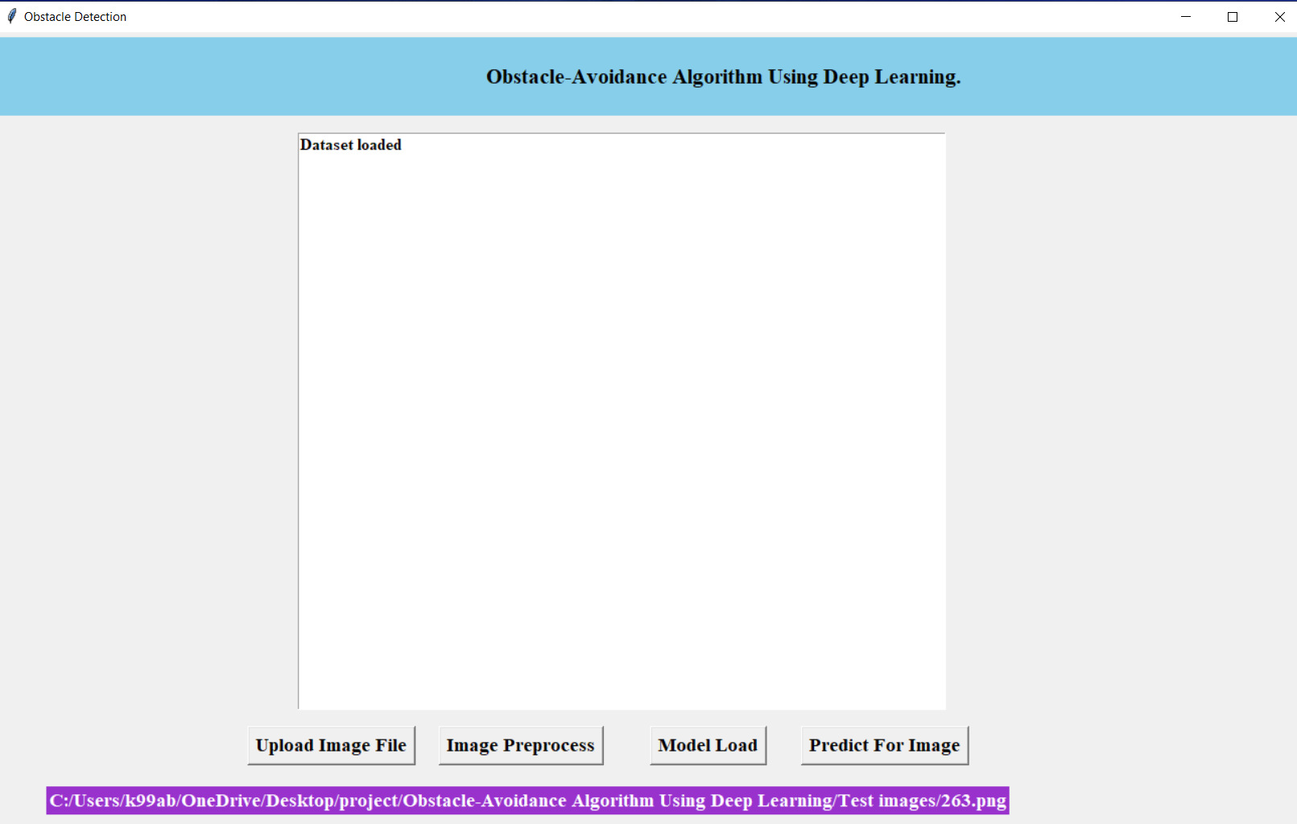
Data set loaded

Slide 22
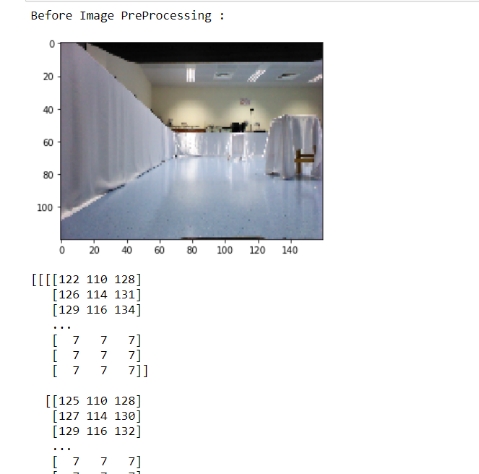

Slide 23
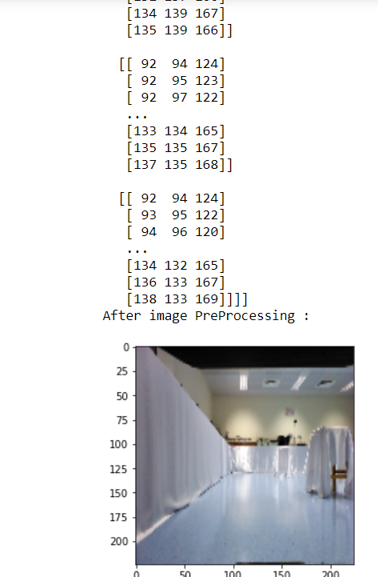

Slide 24
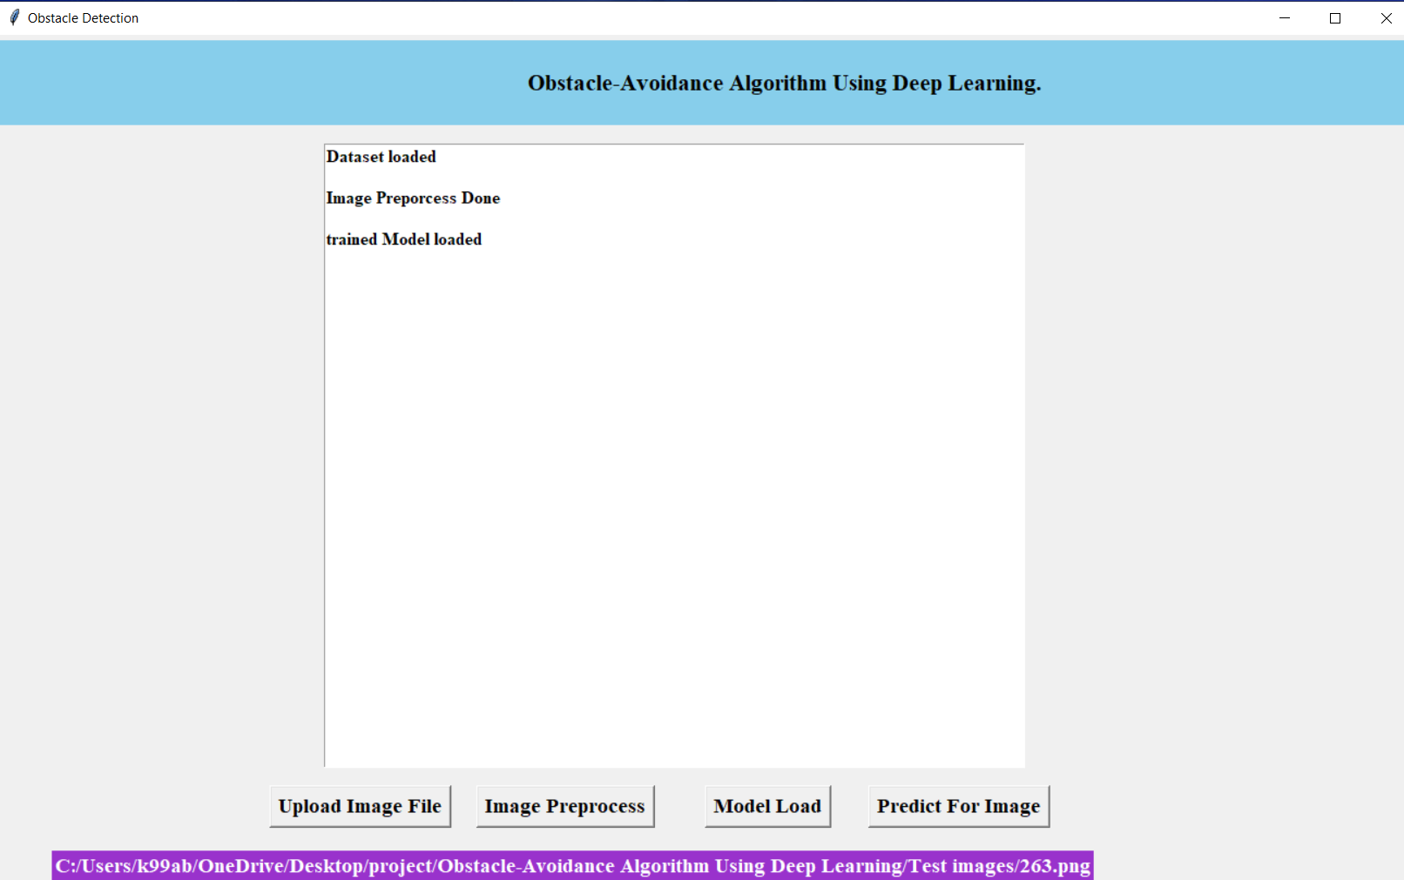
Model is trained

Slide 25
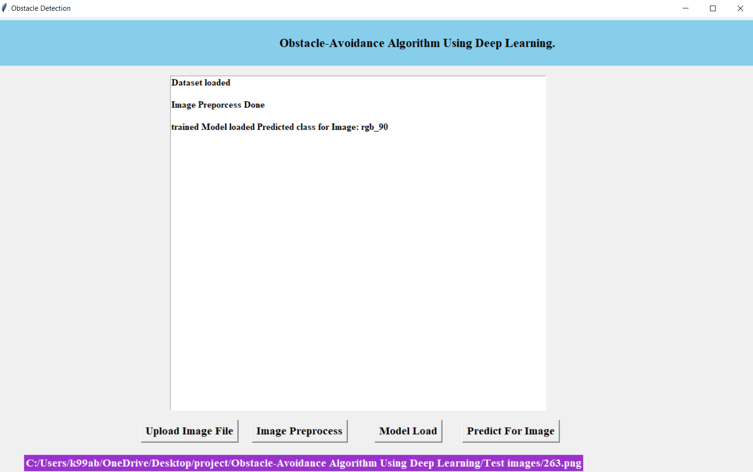
Final output

Slide 26
CONCLUSION AND FUTURE EXTENSION
An obstacle avoidance approach for a mobile robot in indoor environments based on a convolution neural network (CNN) has been developed. A dataset was compiled that contains depth images and robot orientation using a mobile robot platform. The RGBD images obtained by the Kinect camera and the angles acquired by the IMU were recorded

Slide 27
Thank you

